Slide 1
Self-Balancing Search Trees
Based on Chapter 11 of
Koffmann and Wolfgang

Slide 2
Chapter Outline
The impact of balance on search tree performance
Balanced binary search trees:
  AVL trees
  Red-Black trees
Other balanced search trees:
  2-3 trees
  2-3-4 trees
  B-trees
Search and insertion for these trees
Introduction to removal for them

Slide 3
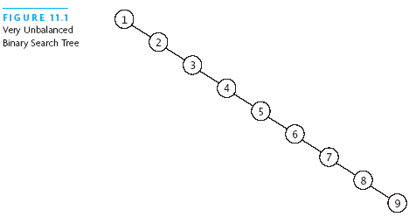
Why Balance is Important
Searches in unbalanced tree can be O(n)

Slide 4
Rotation
For self-adjusting, need a binary tree operation that:
  Changes the relative height of left & right subtrees
  While preserving the binary search tree property
Algorithm for rotation (toward the right):
  Save value of root.left (temp = root.left)
  Set root.left to value of root.left.right
  Set temp.right to root
  Set root to temp

Slide 5
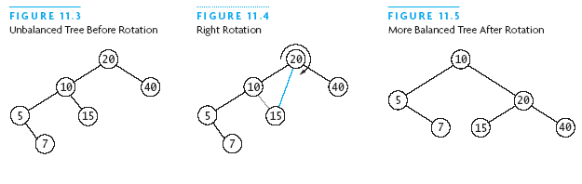
Rotation (2)
Hint: Watch what happens to 10, 15, and 20, below:

Slide 6
Rotation (3)
Nodes v and w decrease in height
Nodes y and z increase in height
Node x remains at same height
y
w
w
z
v
y
v
x
x
z

Slide 7
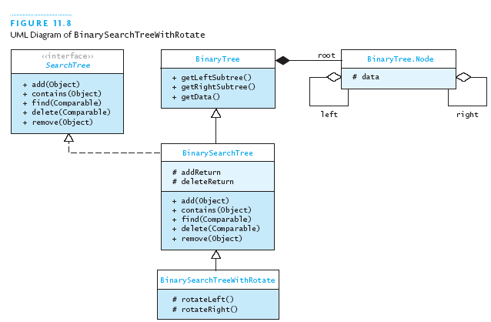
Adding Rotation To BST
Just add rotation methods in this subclass

Slide 8
Coding Rotation
public class BinarySearchTreeWithRotate<
E extends Comparable<E>>
extends BinarySearchTree<E> {
protected Node<E> rotateRight
(Node<E> root) {
Node<E> temp = root.left;
root.left = temp.right;
temp.right = root;
return temp;
}
// rotateLeft is an exercise
}

Slide 9
AVL Tree
Add/remove: update balance of each subtree from point of change to the root
Rotation brings unbalanced tree back into balance
The height of a tree is the number of nodes in the longest path from the root to a leaf node
  Height of empty tree is 0:
    ht(empty) = 0
  Height of others:
    ht(n) = 1+max(ht(n.left), ht(n.right))
Balance(n) = ht(n.right) – ht(n.left)

Slide 10
AVL Tree (2)
The balance of node n = ht(n.right) – ht(n.left)
In an AVL tree, restrict balance to -1, 0, or +1
  That is, keep nearly balanced at each node

Slide 11
AVL Tree Insertion
We consider cases where new node is inserted into the left subtree of a node n
  Insertion into right subtree is symmetrical
Case 1: The left subtree height does not increase
  No action necessary at n
Case 2: Subtree height increases, balance(n) = +1, 0
  Decrement balance(n) to 0, -1
Case 3: Subtree height increases, balance(n) = -1
  Need more work to obtain balance (would be -2)

Slide 12
AVL Tree Insertion: Rebalancing
These are the cases:
Case 3a: Left subtree of left child grew:
  Left-left heavy tree
Case 3b: Right subtree of left child grew:
  Left-right heavy tree
  Can be caused by height increase in either the left or right subtree of the right child of the left child
  That is, left-right-left heavy or left-right-right heavy

Slide 13
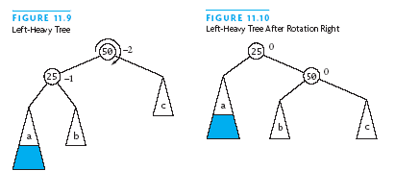
Rebalancing a Left-Left Tree
Actual heights of subtrees are unimportant
  Only difference in height matters when balancing
In left-left tree, root and left subtree are left-heavy
One right rotation regains balance
h = k+1
h = k+2
h = k
h = k+1
h = k
h = k
h = k
h = k+1

Slide 14
Rebalancing a Left-Right Tree
Root is left-heavy, left subtree is right-heavy
A simple right rotation cannot fix this
Need:
  Left rotation around child, then
  Right rotation around root

Slide 15
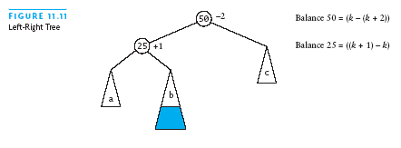
Rebalancing Left-Right Tree (2)
h = k+2
h = k
h = k
h = k+1

Slide 16
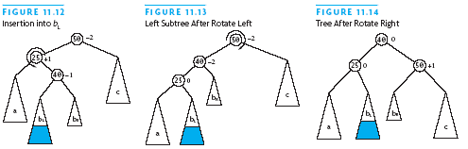
Rebalancing Left-Right Tree (3)
k+3
k+3
k+2
k+2
k+2
k+2
k+1
k
k+1
k+1
k
k
k+1
k+1
k+1
k+1
k+1
k+1

Slide 17
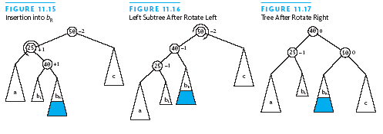
Rebalancing Left-Right Tree (4)
k+3
k+3
k+2
k+2
k+2
k+2
k+1
k+1
k
k+1
k
k
k+1
k+1
k+1
k+1
k+1
k+1

Slide 18
4 Critically Unbalanced Trees
Left-Left (parent balance is -2, left child balance is -1)
  Rotate right around parent
Left-Right (parent balance -2, left child balance +1)
  Rotate left around child
  Rotate right around parent
Right-Right (parent balance +2, right child balance +1)
  Rotate left around parent
Right-Left (parent balance +2, right child balance -1)
  Rotate right around child
  Rotate left around parent

Slide 19
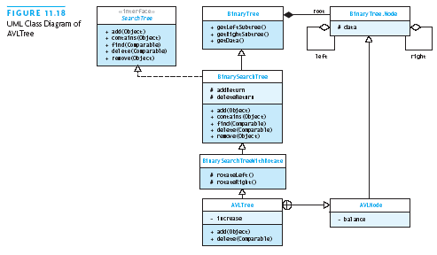
Implementing an AVL Tree
Add +1/0/-1 balance indicator
Add boolean flag to indicate height increase

Slide 20
Code for AVL Tree
public class AVLTree
<E extends Comparable<E>>
extends BinSrchTreeWithRotate<E> {
private boolean increase;
private boolean decrease; // for remove
...
}

Slide 21
Code for AVL Tree (2)
public static class AVLNode<E>
extends Node<E> {
public static final int LEFT_HEAVY = -1;
public static final int BALANCED = 0;
public static final int RIGHT_HEAVY = 1;
private int balance = BALANCED;
public AVLNode (E e) { super(e); }
public String toString () {
return balance+“: “+super.toString();
}
}

Slide 22
Code for AVL Tree (3)
// AVLTree:
public boolean add (E e) {
increase = false;
root = add((AVLNode<E>)root, e);
return addReturn;
}

Slide 23
Code for AVL Tree (4)
// AVLNode:
private AVLNode<E> add
(AVLNode<E> r, E e) {
if (r == null) { // empty tree
addReturn = true;
increase = true;
return new AVLNode<E>(e);
}
if (e.compareTo(r.data) == 0) {//present
increase = false;
addReturn = false;
return r;
}
...

Slide 24
Code for AVL Tree (5)
// AVLNode:
private AVLNode<E> add
(AVLNode<E> r, E e) { ...
if (e.compareTo(r.data) < 0) { // left
r.left = add((AVLNode<E>)r.left, e);
if (increase) {
decrementBalance(r);
if (r.balance < AVLNode.LEFT_HEAVY){
increase = false;
return rebalanceLeft(r);
}
}
return r;
} ... //symmetrical for right subtree

Slide 25
Code for AVL Tree (6)
// AVLTree:
private void decrementBalance
(AVLNode<E> n) {
n.balance--;
if (n.balance = AVLNode.BALANCED) {
increase = false;
}
}

Slide 26
Code for AVL Tree (7)
// AVLTree:
private AVLNode<E> rebalanceLeft
(AVLNode<E> r) {
AVLNode<E> lc = (AVLNode<E>)r.left;
if (lc.balance > AVLNode.BALANCED) {
... // left-right heavy
} else { // left-left heavy
lc.balance = AVLNode.BALANCED;
r.balance = AVLNode.BALANCED;
}
return (AVLNode<E>)rotateRight(r);
}

Slide 27
Code for AVL Tree (7)
// AVLTree.rebalanceLeft
// left-right heavy case
AVLNode<E> lrc = (AVLNode<E>)lc.right;
if (lrc.balance < AVLNode.BALANCED) {
lrc.balance = AVLNode.BALANCED;
lc.balance = AVLNode.BALANCED;
r.balance = AVLNode.RIGHT_HEAVY;
} else {
lrc.balance = AVLNode.BALANCED;
lc.balance = AVLNode.LEFT_HEAVY;
r.balance = AVLNode.BALANCED;
}
r.left = rotateLeft(lc);

Slide 28
Removal from AVL Trees
Add a field called decrease to note height change
Adjust the local node’s balance
  Rebalance as necessary
The balance changed and balancing methods must set decrease appropriately
Actual removal is as for binary search tree
  Involves moving values, and
  Deleting a suitable leaf node

Slide 29
Performance of AVL Trees
Worst case height: 1.44 ⎡log n⎤
Thus, lookup, insert, remove all O(log n)
Empirical cost is 0.25 + log n comparisons to insert

Slide 30
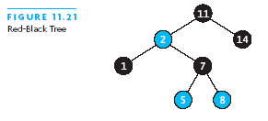
Red-Black Trees
Rudolf Bayer: red-black is special case of his B-tree
A node is either red or black
The root is always black
A red node always has black children
# black nodes in any path from root to leaf is the same

Slide 31
Red-Black Trees
A red node always has black children
This rule means length of longest root-to-leaf path is at most 2 x length of shortest one
Still a binary search tree
  Different kind of balance from AVL tree

Slide 32
Insertion into a Red-Black Tree
Binary search tree algorithm finds insertion point
A new leaf starts with color red
  If parent is black, we are done
  Otherwise, must do some rearranging
    If parent has a red sibling:
      flip parent and sibling to black
      flip grandparent to red
      maintains # black on path to root
      may require further work: repeat on higher level
      if grandparent is root, leave it black

Slide 33
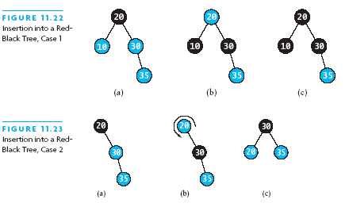
Insertion into Red-Black Tree (2)
If parent has no sibling: swap parent-grandparent colors, and then rotate right around grandparent

Slide 34
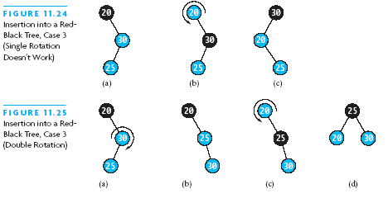
Insertion into Red-Black Tree (3)
Rotation doesn’t work in right-left case, so
  Rotate right at parent, then proceed as before:

Slide 35
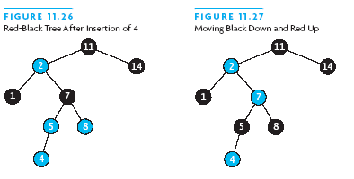
Insertion into Red-Black Tree (4)

Slide 36
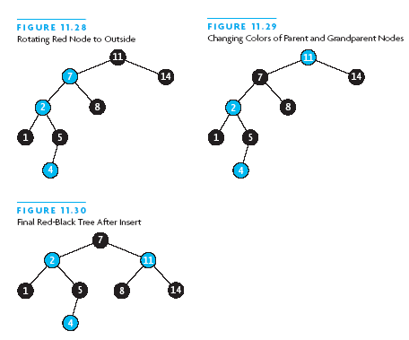
Insertion into Red-Black Tree (5)

Slide 37
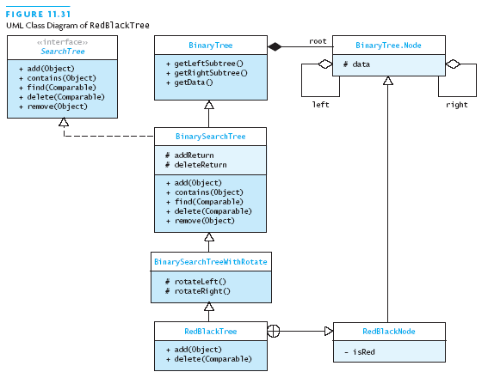
Implementing Red-Black Trees
Add isRed flag

Slide 38
Red-Black Tree Insert Algorithm
public class RedBlackTree
<E extends Comparable<E>>
extends BinSrchTreeWithRotate<E> {
private static class RBNode<E>
extends Node<E> {
private boolean isRed = true;
public RBNode (E e) { super(e); }
public String toString () {
return (isRed ? “R: “ : “B: “) +
super.toString();
}
} ...

Slide 39
Red-Black Tree Code
public class RedBlackTree
<E extends Comparable<E>>
extends BinSrchTreeWithRotate<E> {
private static class RBNode<E>
extends Node<E> {
private boolean isRed = true;
public RBNode (E e) { super(e); }
public String toString () {
return (isRed ? “R: “ : “B: “) +
super.toString();
}
} ...

Slide 40
Red-Black Tree Code (2)
public boolean add (E e) {
if (root == null) {
root = new RBNode<E>(e);
((RBNode<E>)root).isRed = false;
return true;
} else {
root = add((RBNode<E>)root, e);
((RBNode<E>)root).isRed = false;
return addReturn;
}
}

Slide 41
Red-Black Tree Code (3)
private Node<E> add (RBNode<E> r, E e) {
if (e.compareTo(r.data) == 0) {
addReturn = false;
return r;
} else if (e.compareTo(r.data) < 0) {
if (r.left == null) {
r.left = new RBNode<E>(e);
addReturn = true;
return r;
} else {
// continued on next slide

Slide 42
Red-Black Tree Code (4)
moveBlackDown(r);
r.left = add((RBNode<E>)r.left, e);
if (((RBNode<E>)r.left).isRed) {
if (r.left.left != null &&
((RBNode<E>)r.left.left).isRed) {
// left-left grandchild also red
// swap colors and rotate right
((RBNode<E>)r.left).isRed = false;
r.isRed = true;
return rotateRight(r);
} else if (r.left.right != null &&
((RBNode<E>)r.left.right).isRed) {

Slide 43
Red-Black Tree Code (5)
// both grandchildren red:
r.left = rotateLeft(r.left);
((RBNode<E>)r.left).isRed = false;
r.isRed = true;
return rotateRight(r);
}
// other case:
// if left child black after recursion:
// done, nothing more needed
// likewise if neither grandchild is red
// going right is a whole symmetric case

Slide 44
Red-Black Tree Performance
Maximum height is 2 + 2 log n
So lookup, insertion, removal are all O(log n)
Average performance on random values:
  1.002 log n (empirical measurement)
Java API TreeMap and TreeSet use red-black trees

Slide 45
2-3, 2-3-4, and B- Trees
These are not binary search trees ....
Because they are not necessarily binary
They maintain all leaves at same depth
  But number of children can vary
  2-3 tree: 2 or 3 children
  2-3-4 tree: 2, 3, or 4 children
  B-tree: B/2 to B children (roughly)

Slide 46
2-3 Trees
2-3 tree named for # of possible children of each nod
Each node designated as either 2-node or 3-node
A 2-node is the same as a binary search tree node
A 3-node contains two data fields, first < second,
and references to three children:
    First holds values < first data field
    Second holds values between the two data fields
    Third holds values > second data field
All of the leaves are at the (same) lowest level

Slide 47
Searching a 2-3 Tree
if r is null, return null (not in tree)
if r is a 2-node
if item equals data1, return data1
if item < data1, search left subtree
else search right subtree
else // r is a 3-node
if item < data1, search left subtree
if item = data1, return data1
if item < data2, search middle subtree
if item = data2, return data 2
else search right subtree

Slide 48

Inserting into a 2-3 Tree
Inserting into a 2-node just converts it to a 3-node

Slide 49
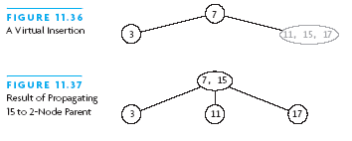
Inserting into a 2-3 Tree (2)
Insertion into a 3-node with a 2-node parent
  Convert parent to 3-node:

Slide 50


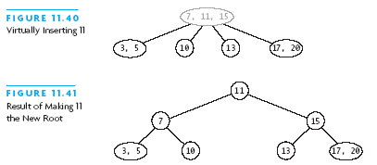
Inserting into a 2-3 Tree (3)

Slide 51
Inserting into a 2-3 Tree (4)
Inserting into 3-node with 3-node parent:
  “Overload” parent, and repeat process higher up:

Slide 52
Insert Algorithm for 2-3 Tree
if r is null, return new 2-node with item as data
if item matches r.data1 or r.data2, return false
if r is a leaf
if r is a 2-node, expand to 3-node and return it
split into two 2-nodes and pass them back up
else
recursively insert into appropriate child tree
if new parent passed back up
if will be tree root, create and use new 2-node
else recursively insert parent in r
return true

Slide 53
2-3 Tree Performance
If height is h, number of nodes in range 2^{h}-1 to 3^{h}-1
height in terms of # nodes n in range log₂ n to log₃ n
This is O(log n), since log base affects by constant factor
So all operations are O(log n)

Slide 54
Removal from a 2-3 Tree
Removing from a 2-3 tree is the reverse of insertion
If the item in a leaf, simply delete it
If not in a leaf
  Swap it with its inorder predecessor in a leaf
  Then delete it from the leaf node
  Redistribute nodes between siblings and parent

Slide 55
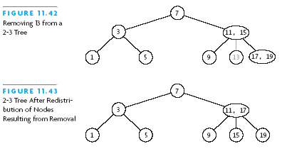
Removal from a 2-3 Tree (2)

Slide 56
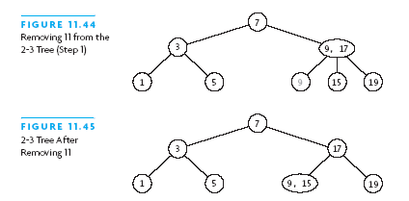
Removal from a 2-3 Tree (3)

Slide 57
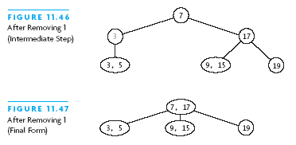
Removal from a 2-3 Tree (4)

Slide 58
2-3-4 and B-Trees
2-3 tree was inspiration for more general B-tree
  It allows up to n children per node
B-tree designed for indexes to very large databases
    Stored on disk
2-3-4 tree is specialization of B-tree: n = 4
A Red-Black tree is a 2-3-4 tree in a binary-tree format
  2-node = black node
  4-node = black node with two red children
  3-node = black node with one red child

Slide 59

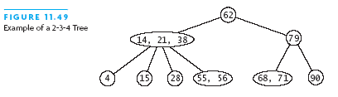
2-3-4 Trees
Expand on the idea of 2-3 trees by adding the 4-node
Addition of this third item simplifies the insertion logic

Slide 60
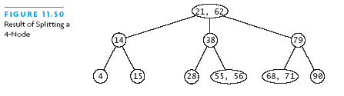
2-3-4 Trees (2)
Addition of this third item simplifies the insertion logic

Slide 61
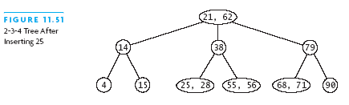
2-3-4 Trees (3)
Insert new item after splitting:

Slide 62
Algorithm for 2-3-4 Tree Insert
if root is null, create new 2-node for item, return true
if root is 4-node
split into two 2-node, with middle value new root
set index to 0
while item < data[index], increment index
if items equals data[index], return false
if child[index] is null
insert into node at index, moving existing right
else if child[index] does not reference a 4-node
recurse on child[index]
// continued on next slide

Slide 63
Algorithm for 2-3-4 Tree Insert
else // child[index] is a 4-node
split child[index]
insert new parent into node at index
if new parent equals item, return false
if item < new parent, search child[index]
else search child[index+1]

Slide 64
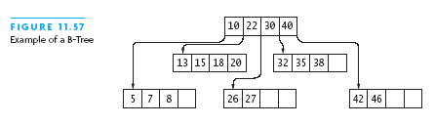
B-Trees
B-tree extends idea behind 2-3 and 2-3-4 trees:
  Allowa a maximum of CAP data items in each node
Order of a B-tree is maximum # of children for a node
B-trees developed for indexes to databases on disk

Slide 65
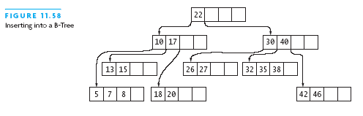
B-Tree Insertion
new value = 17

